Slide 1

WP4.3: Impact Assessment Review
Rafael Segundo, Jan Lavenius and Luigi Vanfretti – KTH
Brussels, April 8th, 2013

Slide 2
Goals of the presentation
To provide a summary of the current indices addressing concerns raised by WP5 about the current indices.
Information request to partners
The work to be done in WP4.3 in Q2 and onwards in 2013.

Slide 3
Review of the indices
Following a dynamic simulation for a specific contingency, we will use the output data to calculate a set of severity indexes. These should indicate the severity of the contingency.
The indexes will indicate:
If the system will converge to a safe and stable equilibrium point.
To indicate the severity of the instability/stability for each type instability mechanism
Static concerns |  | Dynamic concerns
1. Post-fault overloads of lines | 2. Post-fault bus under- or over-voltages | 3. Small-signal stability | 4. Transient stability | 5. Voltage stability

Slide 4
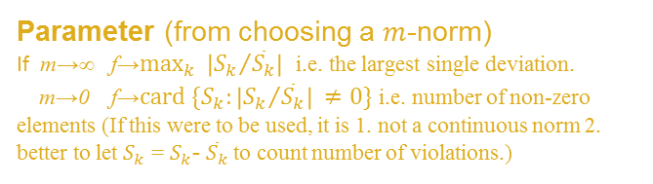
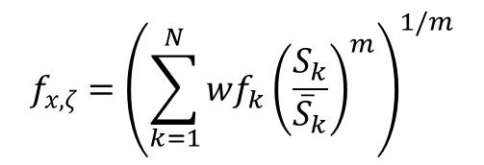
1. Post-fault Overloads Index
Indicate if the post-fault line flows exceed the network capacity by observing the power flows through the transmission lines after an outage occurs.
Weighting factor
i.e. wfk=[1,1,…,1] for a uniform weight
post-fault flow trough transmission line k
(from dynamic simulation)
Capacity of transmission line k (from network data)
WP5’s concern: “The static indices may result to be very system-dependent, as it is performs the pure summation of branch loadings, and you may have very different number of branches from system to system”
We note that index is not a simple summation, it is in fact a norm (or pseudo-norm if m<1): we can use our weights wfk to give more importance to a specific line. We can implement WP5 suggestion by giving weights wfk proportional to the line rating of line k.

Slide 5
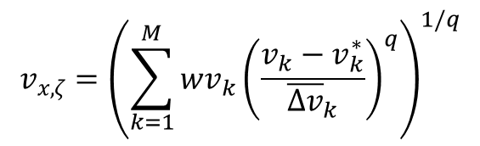
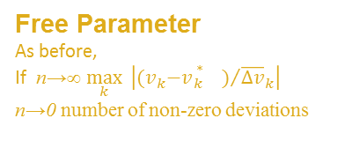
2. Post-fault Under-/Over-Voltage Index
Indicates whether or not the bus voltages deviations exceed those acceptable in the grid code, by observing the voltage across the transmission network after a contingency has occurred.
Bus voltage magnitudes
(from dynamic simulation)
Rated voltage
(from network data)
Weighting factor
i.e. wvk=[1,1,…,1] for a uniform weight
maximum acceptable voltage deviation (from the network data)
Note that:
As before the index is not a simple summation and we can use weights vx,k to give more importance to specific nodes.
We will test current indices using real data from partners, we can alternatively use WP5 suggestions if the presented indices fail.

Slide 6



3. Small-signal Stability Index - Prony
Damping ratio estimation from dynamic simulation sequences. Prony- and ERA-methods suitable.
The Prony method
This approach estimates the parameters of a given signal by fitting a sum of complexly damped sinusoids to a sequence of evenly spaced samples.
Phase angle of component
Estimated signal with N samples
Damping coefficient
Or rewritten as
Frequency
Amplitude of coefficient i
Prony analysis is done in three steps:
1) Solve linear prediction model, constructed by observed data:

Slide 7

3. Small-signal Stability Index – Prony cont.
2) Find the roots of the characteristic polynomial, formed from the linear prediction coefficients
Solve the original se of linear equations to yield the estimates of the exponential amplitude and sinusoidal phase.
EXAMPLE:
possible to accurate estimate the damping ratio of the system.
Challenging to automating this approach.
Prony |  | Actual
Frequency (Hz) | Damping (%) | Frequency (Hz) | Damping (%)
0.28 | 4.2 | 0.29 | 4.8
0.56 | 10.45 | 0.55 | 5.3

Slide 8

3. Small signal stability index - ERA
Eigensystem Realization Algorithm (ERA)
ERA is an identification method which can be used to identify electromechanical modes. It is based on the singular value decomposition of the Hankel matrix H(0) associated with the impulse response of the system
where P and Q are matrices of singular vectors and S is a diagonal matrix of singular values. The identification matrix can be computed as:
The system order is related to the number of the singular values of the matrix H(0).

Slide 9
3. Small signal stability index – ERA cont.
Prony |  | Actual
Frequency (Hz) | Damping (%) | Frequency (Hz) | Damping (%)
0.29 | 4.4 | 0.29 | 4.8
0.55 | 5.9 | 0.55 | 5.3
Major Challenges in both procedures
Correct window to be analyzed
Right estimated order
Difficult automating the procedure
possible to accurate estimate the damping ratio of the system.
Challenging to automating this approach.

Slide 10
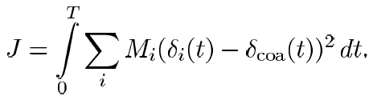
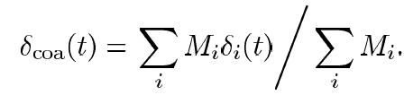
4. Transient stability (rotor-angle stability)
Multimachine integral square generator angle index (ISGA).
General definition
Generator angles
Center of angle (COA)
Machines inertias (2 *H)
Definition for stable events
WP5 Concern: “how is it evaluated in case of instability?”
The index can be used to judge the severity of stable and unstable transient events in simulations.
If the angular deviation from the center of inertia increases as time propagates, then the case will be labeled as unstable.

Slide 11
5. Voltage stability index
We calculate the voltage stability index by computing the distance to the post-contingency loadability limit. Here, quasi-steady state (QSS) simulations are suggested to be used in order to speed up the calculation.
Margin shown is only specific load increase direction, dim(loadspace)=1
The system will contain multiple PV-curves if dim(loadspace)>1
therefore an infinite number of combinations of load increases (which leafs to voltage collapse) exist.
Example: a single PV-curve
We will increase the load (from a reduced loading point) in the post-contingency system until we get a voltage collapse, which will give the margin to the loadability limit.
If we cannot increase the loading, we are definitively voltage unstable, and we have a zero or negative margin.
For more realistic systems, the PV-curves are not smooth but piece-wise smooth parts of different PV-curves.
Original loadingpoint
Load increase
Reduced loading
Original loading
Loading when voltage collapses

Slide 12
Information Required
(As in Telco 14March)
Table 1 (from network)
Abbreviation | Details | Units | Order
nl | Number of transmission lines |  | 1
nb | Number of buses (nodes) |  | 1
nm | Number of Synchronous Machines |  | 1
Vn | Base line-to-line voltage of the buses to which the terminal of the line is connected | KV | nl x 1
In | Line rated current | A | nl x 1
Imax | Maximum line current | p.u. | nl x 1
*Sn | Line rated power (firs loading rating) | MVA | nl x 1
**Smax | Power limit in transmission lines | p.u. | nl x1
H | Constant of Inertia (machine inertia) | MWs/MVA | nm x 1
*Sn=(Vn)(In)
**Smax=(Vn)(Imax)
If Sn and Smax are not give, then we require the values of (nominal voltage) Vn, (Nominal Current) In and (Max current) Imax in transmission lines from the datasheets

Slide 13
Time domain data
Table 2 (from simulations)
Abbreviation | Details | Units | Order
nt | Number of sampling time (lenght of time vector) |  | scalar
t | Simulation time | sec | nt x 1
Vb_m | Bus voltage magnitudes | p.u. | ntx1
Vb_a | Bus voltage angles | rad | ntx1
Ib_m | Bus current magnitude | p.u. | ntx1
Ib_a | Bus current angles | rad | ntx1
Pji, Qij | Active and Reactive line flows | p.u. | nl x 1
Pji, Qij | Active and Reactive line flows | p.u. | nl x 1
Sij, Sji | Apparent line flows | p.u. | nl x 1

Slide 14
Table 3
Abbreviation | Details | Units | Order
n | Number of states in the system |  | scalar
x.states | States of the system | p.u. | nt x n
x.names | Name of the state variables in the correct order | strings | nt x variable
States indexes deltas omega | Indices in the state vector such as: Machines rotor angle indices in the state vector Rotor speed indices in the state vector |  | variable

Slide 15
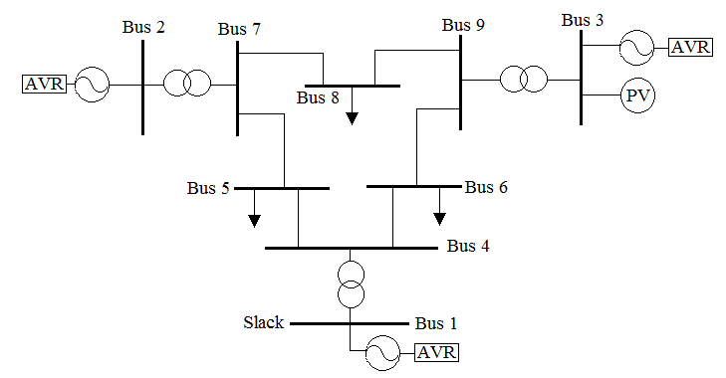

Illustrative example
If possible provide a diagram indicating the place and the disturbance applied to the system
Any other extra information will be valuable
Three phase fault at 5sec
Matlab files with vectors and variables with network information
Vn= | 230
 | 230
 | 230
 | 230
 | 230
 | 230
 | 18
 | 13.8
 | 16.5
Sn= | 100
 | 100
 | 100
 | 100
 | 100
 | 100
 | 100
 | 100
 | 100
Smax= | 250
 | 250
 | 250
 | 250
 | 250
 | 250
 | 250
 | 250
 | 500
H= | 23.64
 | 6.40
 | 3.01
nl=9 | Number of transmission lines
nb=9 | Number of buses (nodes)
nm=3 | Number of Synchronous Machines

Slide 16
Time domain data
Line Flows
Pij= | 0.2724
 | 0.7351
 | 0.5459
 | 0.7807
 | -0.4937
 | -0.3681
 | 1.5158
 | 0.8183
 | 0.8674
Qij= | 0.0257
 | -0.0041
 | -0.1785
 | -0.0852
 | -0.3677
 | -0.1518
 | 0.0473
 | -0.1148
 | 0.2579
Pji= | -0.2714
 | -0.7307
 | -0.5350
 | -0.7620
 | 0.4969
 | 0.3704
 | -1.5158
 | -0.8183
 | -0.8674
Qji= | -0.2365
 | -0.1142
 | -0.1492
 | -0.1346
 | 0.2147
 | -0.0003
 | 0.0894
 | 0.1529
 | -0.2144
Sij= | 0.2736
 | 0.7351
 | 0.5743
 | 0.7853
 | 0.6156
 | 0.3982
 | 1.5165
 | 0.8263
 | 0.9049
Sji= | 0.3600
 | 0.7395
 | 0.5554
 | 0.7738
 | 0.5413
 | 0.3704
 | 1.5184
 | 0.8324
 | 0.8935
Voltage/Current magnitudes and angles
Vb_m= | 0.0626
 | 0.0626
 | 0.0626
 | 0.0626
 | 0.0626
 | 0.0626
 | 0.0626
 | 0.0626
 | 0.0626
Vb_a= | 0.0626
 | 0.0626
 | 0.0626
 | 0.0626
 | 0.0626
 | 0.0626
 | 0.0626
 | 0.0626
 | 0.0626
Ib_m= | 1.8500
 | 1.8500
 | 1.8500
 | 1.8500
 | 1.8500
 | 1.8500
 | 1.8500
 | 1.8500
 | 1.8500
Ib_a= | 0.8354
 | 0.8354
 | 0.8354
 | 0.8354
 | 0.8354
 | 0.8354
 | 0.8354
 | 0.8354
 | 0.8354

Slide 17
 | STATES
 | x1 | x2 | x3 | x4 | x5 | ………… | x24
x= | 0.1129 | 0.0355 | -0.2130 | 0.7059 | -1.1555 | ………… | -0.7778
 | 0.4400 | 2.2272 | -0.8657 | 1.4158 | -0.0095 | ………… | -1.0649
 | 0.1017 | -0.0692 | -1.0431 | -1.6045 | -0.6898 | ………… | -1.7684
 | 2.7873 | -0.5073 | -0.2701 | 1.0289 | -0.6667 | ………… | -0.4229
 | -1.1667 | 0.2358 | -0.4381 | 1.4580 | 0.8641 | ………… | -1.0531
 | -1.8543 | 0.2458 | -0.4087 | 0.0475 | 0.1134 | ………… | 0.6478
 | -1.1407 | 0.0700 | 0.9835 | 1.7463 | 0.3984 | ………… | -0.3176
 | -1.0933 | -0.6086 | -0.2977 | 0.1554 | 0.8840 | ………… | 1.7690
 | -0.4336 | -1.2226 | 1.1437 | -1.2371 | 0.1803 | ………… | 1.5106
 | -0.1685 | 0.3165 | -0.5316 | -2.1935 | 0.5509 | ………… | 0.1640
 | -0.2185 | -1.3429 | 0.9726 | -0.3334 | 0.6830 | ………… | -0.2828
 | 0.5413 | -1.0322 | -0.5223 | 0.7135 | 1.1706 | ………… | 1.1522
 | 0.3893 | 1.3312 | 0.1766 | 0.3174 | 0.4759 | ………… | -1.1465
 | 0.7512 | -0.4189 | 0.9707 | 0.4136 | 1.4122 | ………… | 0.6737
 | 1.7783 | -0.1403 | -0.4140 | -0.5771 | 0.0226 | ………… | -0.6691
 | 1.2231 | 0.8998 | -0.4383 | 0.1440 | -0.0479 | ………… | -0.4003
 | -1.2833 | -0.3001 | 2.0034 | -1.6387 | 1.7013 | ………… | -0.6718
 | -2.3290 | 1.0294 | 0.9510 | -0.7601 | -0.5097 | ………… | 0.5756
 | 0.9019 | -0.3451 | -0.4320 | -0.8188 | -0.0029 | ………… | -0.7781
 | -1.8356 | 1.0128 | 0.6489 | 0.5197 | 0.9199 | ………… | -1.0636
 | 0.0668 | 0.6293 | -0.3601 | -0.0142 | 0.1498 | ………… | 0.5530
TIME
t= | 0
 | 0.5000
 | 1.0000
 | 1.5000
 | 2.0000
 | 2.5000
 | 3.0000
 | 3.5000
 | 4.0000
 | 4.5000
 | 5.0000
 | 5.5000
 | 6.0000
 | 6.5000
 | 7.0000
 | 7.5000
 | 8.0000
 | 8.5000
 | 9.0000
 | 9.5000
 | 10.0000
Number of states
n=24
Note that this is an illustrative example and we are assuming that we have access to all the states

Slide 18
In this form, if we require to use the rotor angle states (delta) to calculate transient stability, we do the following:
x.names= | delta_1
 | omega_1
 | e1d_1
 | e1d_1
 | delta_2
 | omega_2
 | e1d_2
 | e1d_2
 | delta_3
 | omega_3
 | e1d_3
 | e1d_3
 | vm_1
 | vr1_1
 | vr2_1
 | vf_1
 | vm_2
 | vr1_2
 | vr2_2
 | vf_2
 | vm_3
 | vr1_3
 | vr2_3
 | vf_3
NDEX OF ATES REALTED TO THE SYNCHRONOUS MACHINE
Rotor angle |  |  | Rotor speed |  |  | q-axis transient voltage |  | d-axis transient voltage
delta= | 1 |  | omega= | 2 |  | e1q= | 3 | e1d= | 4
 | 5 |  |  | 6 |  |  | 7 |  | 8
 | 9 |  |  | 10 |  |  | 11 |  | 12
INDEX OF STATES RELATED TO THE AVR CONTROL
vm= | 13 |  | vr1= | 14 |  | vr2= | 15 |  | vf= | 16
 | 17 |  |  | 18 |  |  | 19 |  |  | 20
 | 21 |  |  | 22 |  |  | 23 |  |  | 24
To extract the values of the rotor angle states from the state vector:
x(:,delta)=[colum1, column5, colum9]

Slide 19
Future work in Q2 2013
Obtain output from time-domain simulations from different WP4.3 partners.
Expected delivery of data by 29 April 2013.
Test current indices using real data.
Dependent on receiving data from WP4.3 partners.
Need to address any problems between the partners due to different softwares
Unfortunately, due to lack of time, not possible to master Eurostag or its API
Expected to finish the testing by end of Q3, depending on data availability and if any indices needs replacement.
Implementing any changes to the indices, if necessary
Use WP5 suggestions if the current indices should fail, or if
Supplementary indices that WP5 needs have to be implemented.
Start writing on the deliverable D4.3
Expected to be submitted in its final version by end of Q3, 2013 (M21)

